Slide 1
2022 ProSeed team 10
App “Covidly”
By yuang Hou, leona Li, hairong Wu, shihming Lin, shiyu Sun

Slide 2
Introduction
An app that displays the covid infections for each building/place at UW campus.
Has three major displays with specific functions
Uses data from shared database.
Serves large organizations including colleges, industries or activities that take place in a specific area.

Slide 3
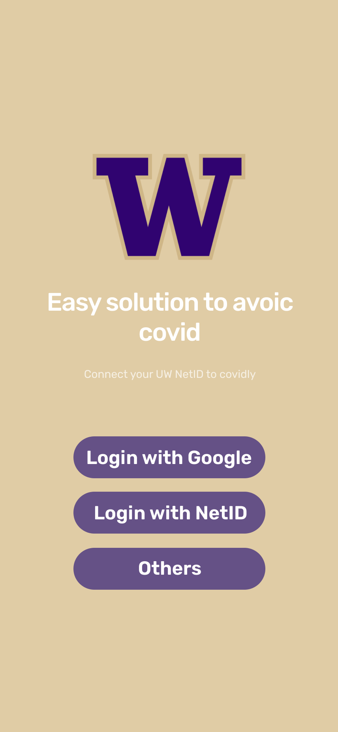
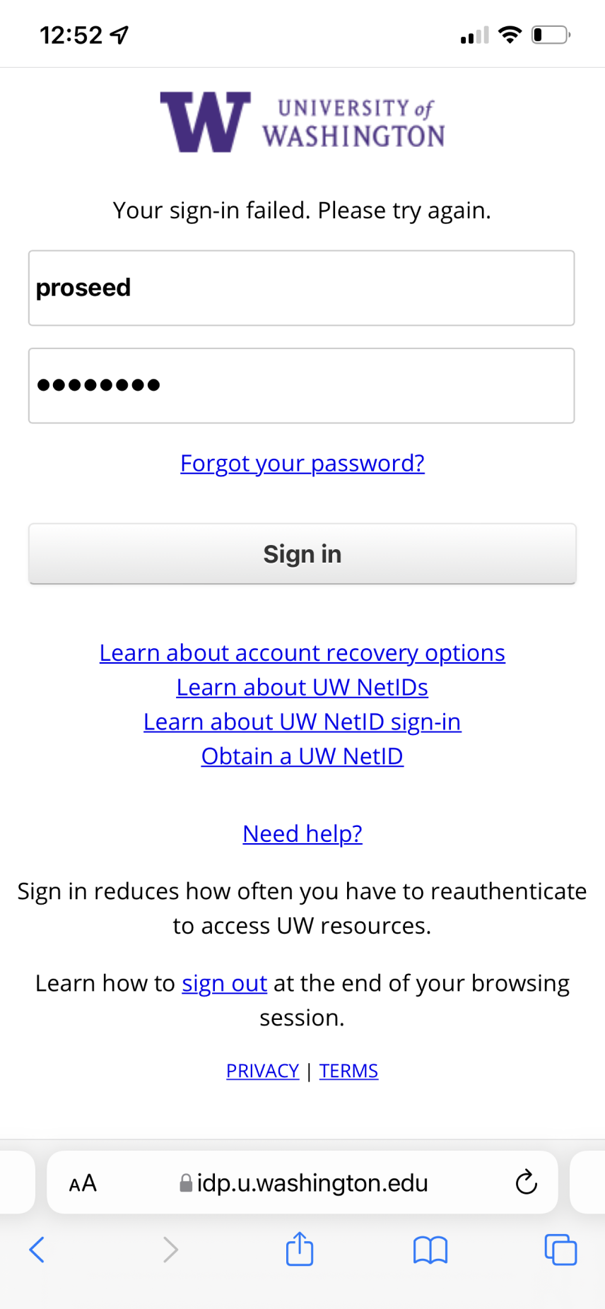
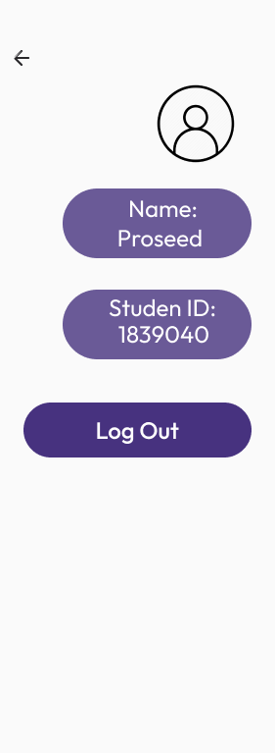
Login page

Slide 4
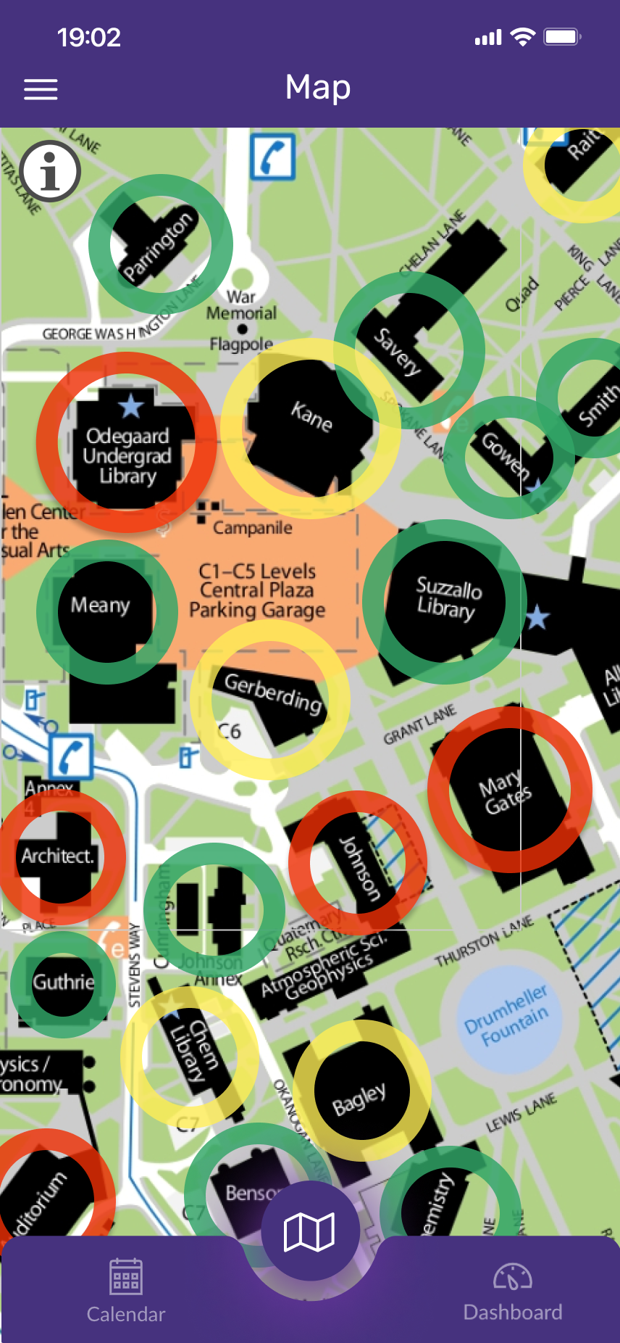
Main display 1
Shows up after login
Displays the map of UW campus
Users can press buildings/places to see their covid infection information.
After hitting the bottom, information of the building pressed will be popped up from bottom of the screen.

Slide 5
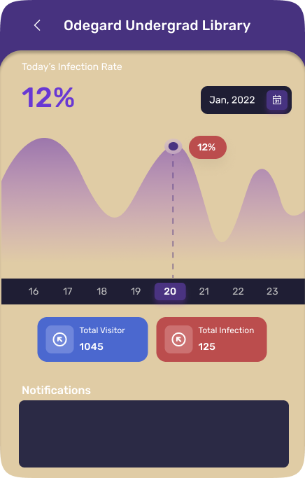
Features of display 1
Information popped up from bottom of the screen.

Slide 6
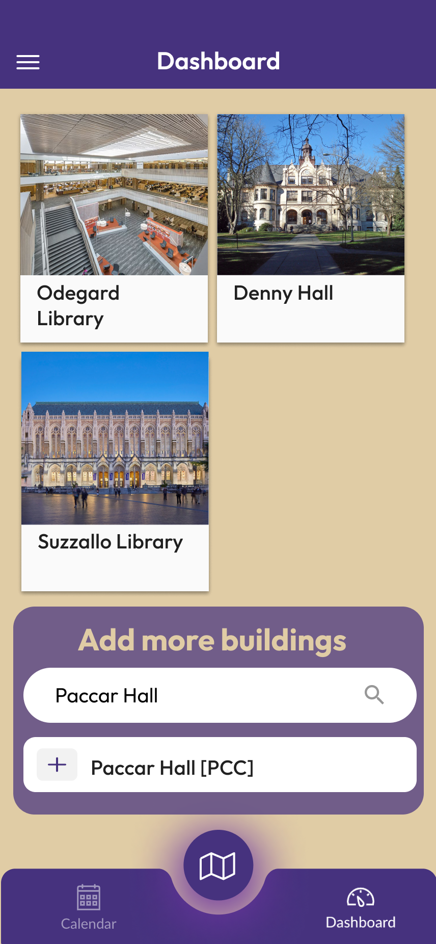
Display 2
Shows up after pressing the Dashboard.
Users can have specific buildings/destinations that they want to keep track of in the long-term.
Default buildings will be the ones that students’ courses are located based on MyPlan

Slide 7
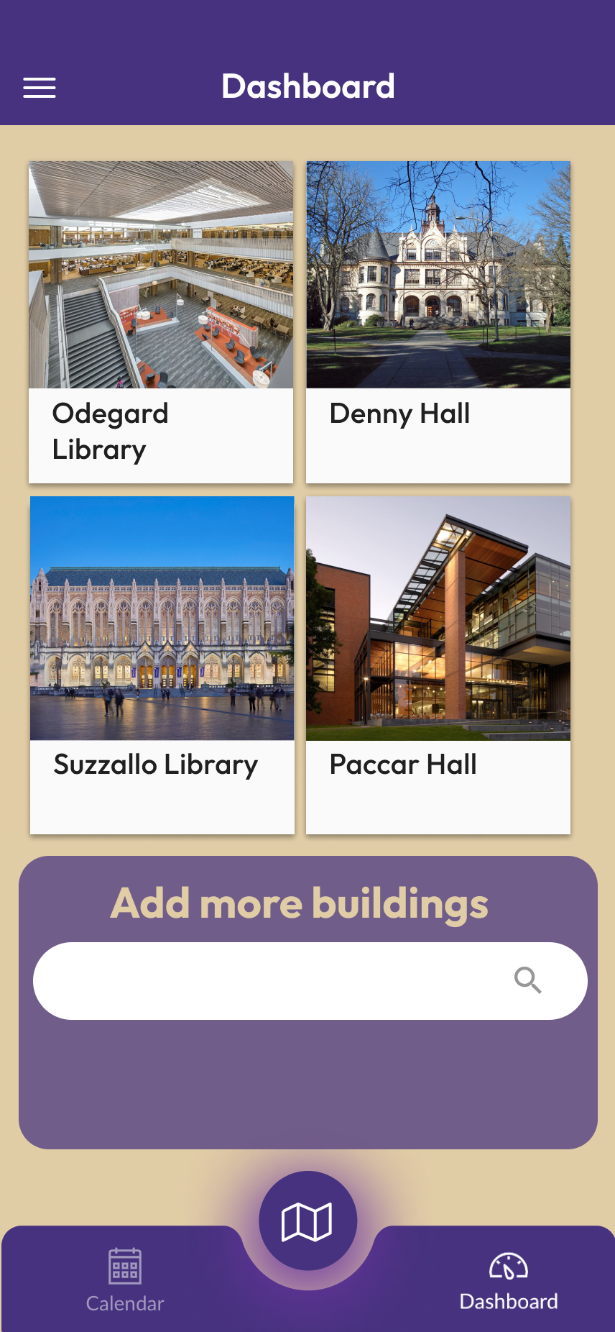
Features of display 2
Users can hit the add bottom to add more buildings except the default ones.

Slide 8
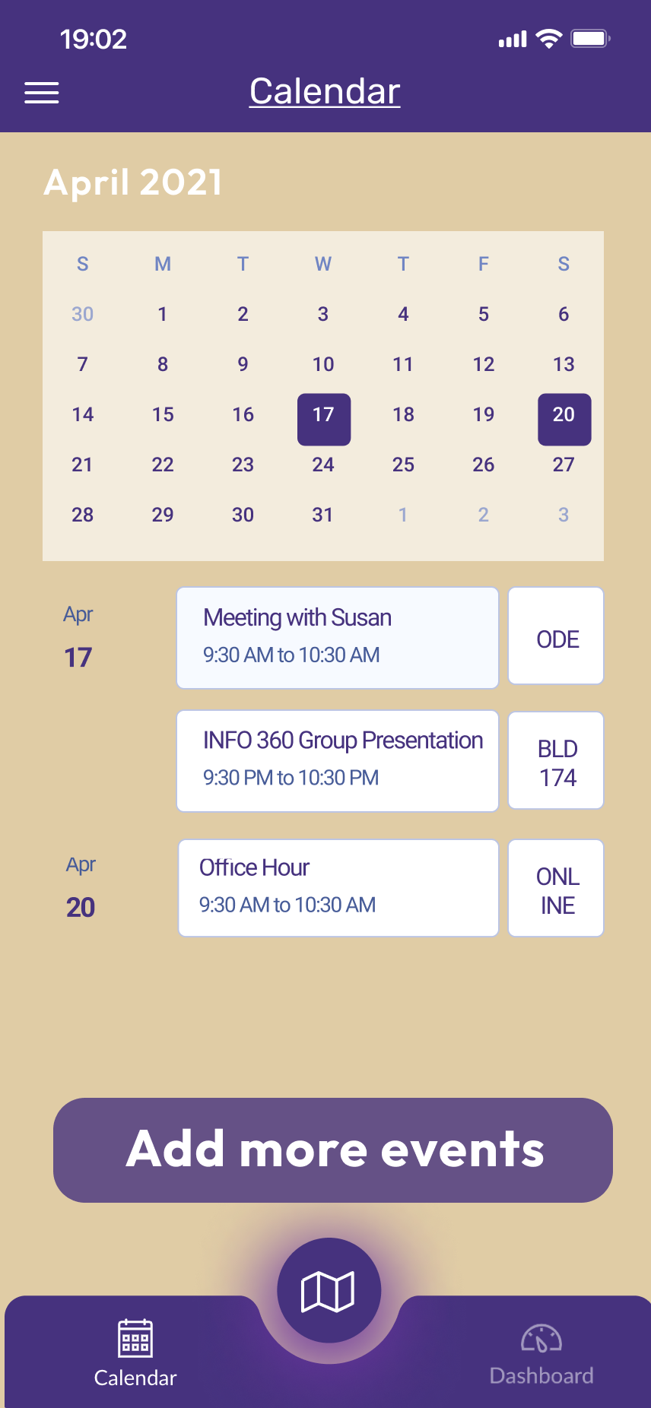
Display 3
Shows up after pressing the Calendar button.
Users can see their scheduled events with the specific buildings based on the information on MyPlan.

Slide 9
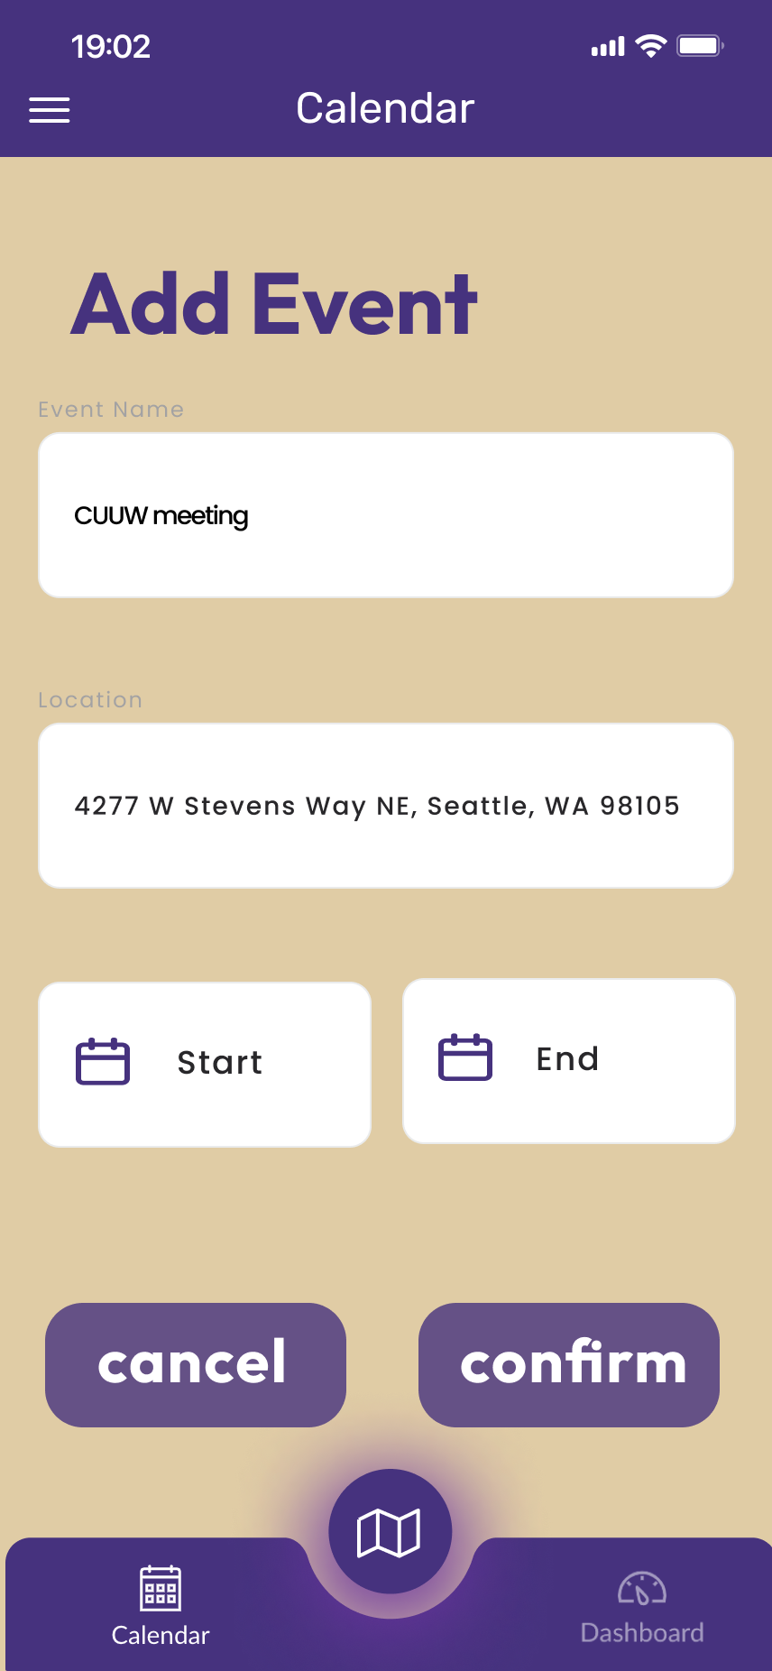
Features of display 3
Users can press the add button to create new customized events to the current schedule.

Slide 10
Product reviews
Who will buy your product? Who is your target group?
Colleges, social media companies, government healthcare agencies, college unions.
Target on students, staff, all people who worry about their travel routes during pandemic
Why will people buy your product?
It is easy to for students and staff to know about the conditions of their travel destinations. Easy to plan their travel routes with a better time management. Easy to build their own events with a clear understanding of conditions of their events destination.
What problem does it solve?
It helps users know about their risks of being exposed to covid. It helps users make a safer traveling choice.
Where is your market?
Mainly opens to areas with loose covid policies. Especially in US. Also our markets can be specified to, but not limited to schools, workplace, industries, or places where some forms of human organizations base in.

Slide 11
Future Plans
Expand to a national/state/provincial service app with new features including more sophisticated data, calculated possibilities of getting covid, or recommended routes.
Building an online community for people to share their lives under pandemic.
Helps small businesses to sell personal protective equipment.
Becomes a travel service app that benefits tourists from noting the risk levels of each landmark.
Becomes a built-in function under large social media app including, snapchat, wechat, facebook, google map.

Slide 12
Thank you!!!
By shiyu Shi, hairon Wu, leona Li, shihming Lin, yuang Hou

